Slide 1
a Modified Engineering Design Process(EDP)
to Utilize Computer-Aided Design(CAD) in
K-12 and University Level
Ceren, Dolu*
Student, Hisar School IdeaLab Computer Science, ceren.dolu@hisarschool.k12.tr

Slide 2
Problem

Slide 3
“In order to save time and money, designers need to understand the utility of different engineering representations. To this end, designers often rely on past experience to decide which model to construct; yet students without this experience have no help.”
[1] (Hannah et al 2012)

Slide 4
“Students were found to have considerable difficulty making estimates for common engineering quantities, such as force and energy. Students were also found to have difficulty applying basic engineering concepts in rough estimation situations even at the senior level.”
[4] (Linder 1999)

Slide 5
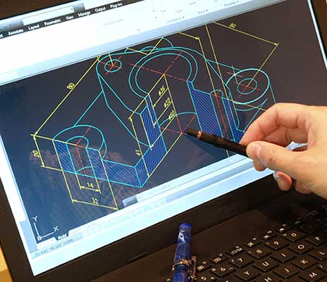
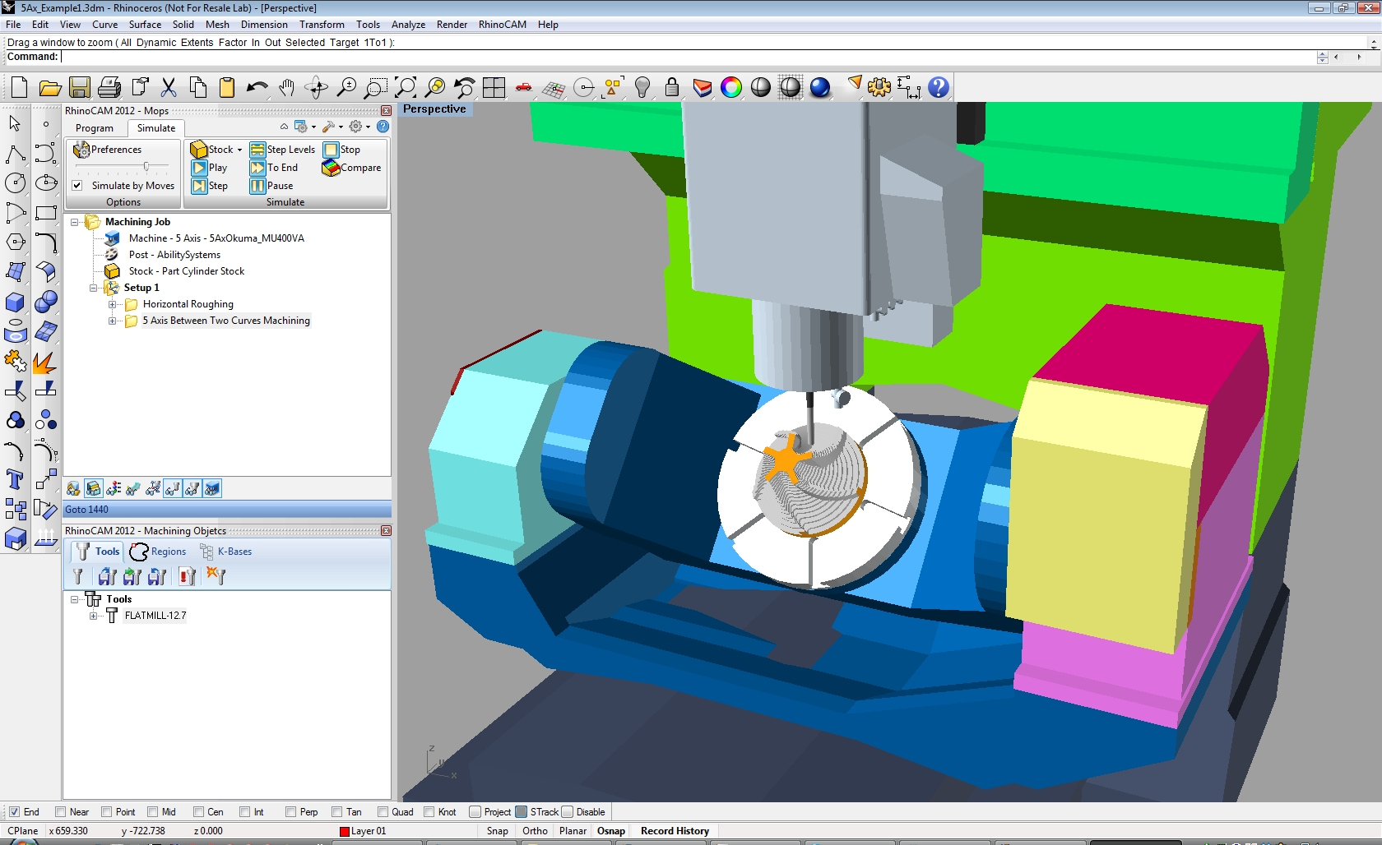
Computer-Aided Design (CAD)
Computer-Aided Manufacturing (CAM)

Slide 6
Solution

Slide 7
Utilize CAD familiarity gained during covid
High-fidelity prototypes at student level
“Four of the six novice designers observed expressed difficulty in visualising the design while working on the computer. They expressed the need to visualise in three dimensions (3-D) or to be able to see a physical model in order to understand better the component or assembly (categorised as visualise in 3-D).”
[7](Ahmed, et al. 2003)
“The results reveal that designers are more confident and correct in making conclusions about whether a design meets requirements when using high-fidelity representations and physical representations, specifically high-fidelity prototypes.”
[1](Hannah et al. 2012)

Slide 8
“Students seldom used estimates to determine the feasibility of an idea or to justify material or component selections, even when give explicit instructions to do so. Many students in the senior design course were found to need considerable help with their estimates to be successful.”
[4] (Linder 1999)

Slide 9
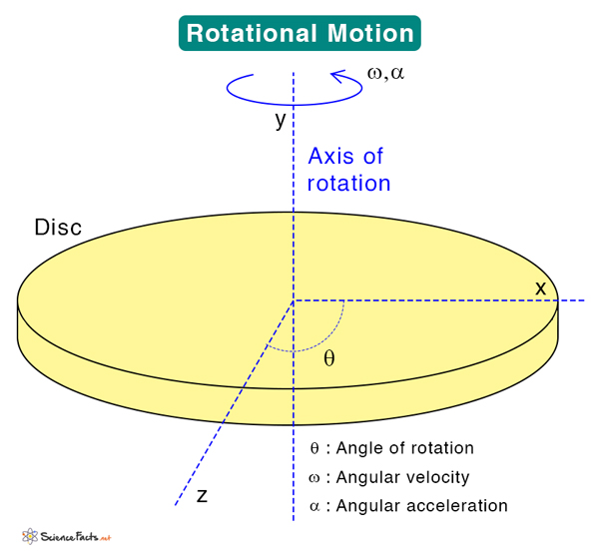
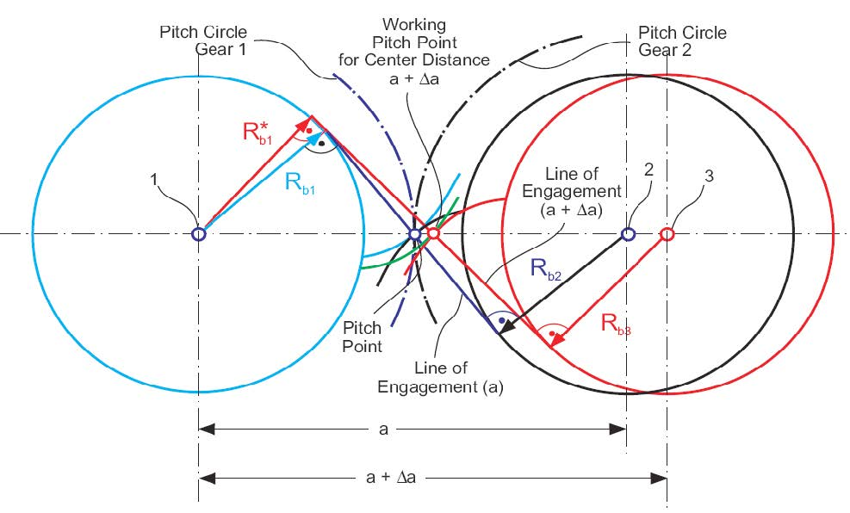
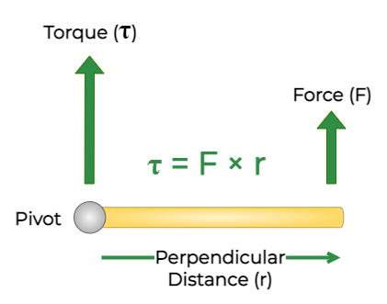
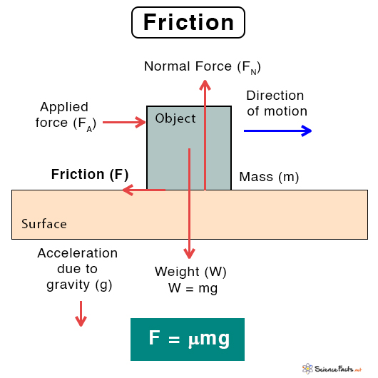
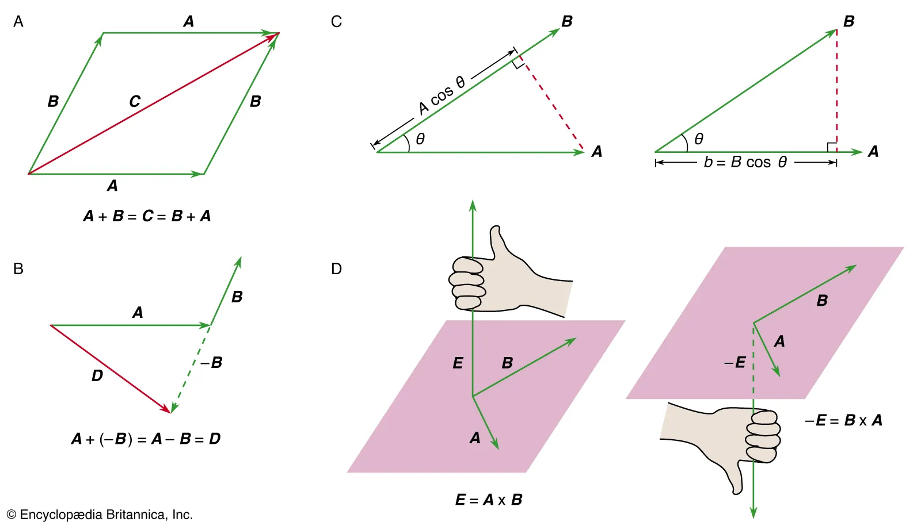
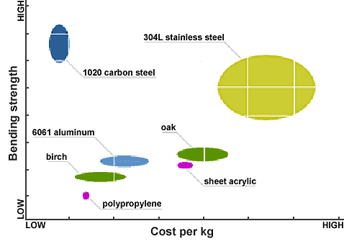

Slide 10
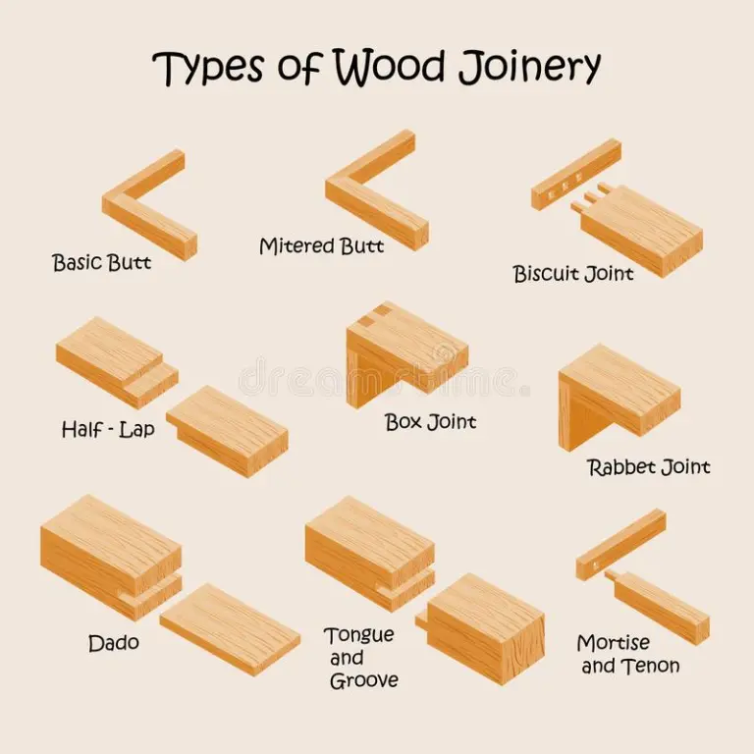
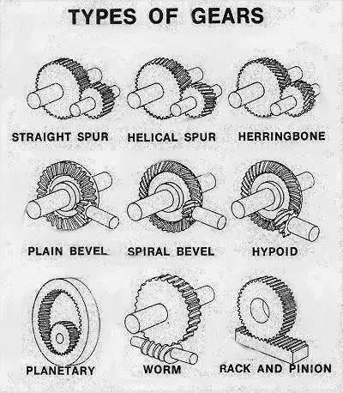
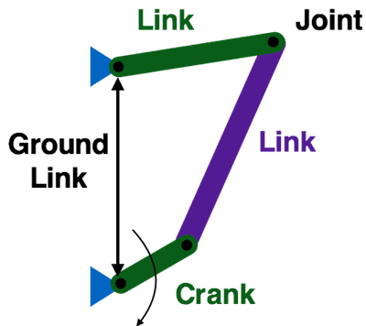

Slide 11
References
[1]
[2]
[3]
[4]
[5]
[6]
[7]
[8]
[9]
Hannah R., Joshi S., Summers J.D. (2012) A user study of interpretability of engineering design representations, Journal of Engineering Design, 23:6, 443-468, DOI: 10.1080/09544828.2011.615302
Wind, S.A., Alemdar, M., Lingle, J.A (2019) Exploring student understanding of the engineering design process using distractor analysis, IJ STEM Ed, 6:4, DOI: 10.1186/s40594-018-0156-x
Song T., Becker K., Gero J., et al. (2016) Problem Decomposition and Recomposition in Engineering Design: a Comparison of Design Behavior Between Professional Engineers, Engineering Seniors, and Engineering Freshmen, Virginia Tech Publishing, 27:2, DOI: 10.21061/jte.v27i2.a.3
Linder B.M. (1999) Understanding Estimation and its Relation to Engineering Education, Massachusetts Institute of Technology
Katehi L., Pearson G., Feder M. (2009) Engineering in K-12 education: Understanding the status and improving the prospects, Washington, DC: The National Academies Press. DOI: 10.17226/12635
Adams, J., Kaczmarczyk, S., Picton, P., et al. (2009) Problem solving and creativity in Engineering: turning novices into professionals, Enhancing the Learner Experience in Higher Education, 1:1, 4–18. DOI: 10.14234/elehe.v1i1.6
Ahmed S., Wallace K. M., Blessing L. (2003) Understanding the differences between how novice and experienced designers approach design tasks, Research in Engineering Design, 14, 1:11+. DOI: 10.1007/s00163-002-0023-z
Valentine A., Belski I., Hamilton M. (2016). Engaging engineering students in creative problem solving tasks: How does it influence future performance, 44th SEFI Conference, 12-15.
Stevens R., Johri A. O’Connor K. (2014) Professional Engineering Work, Cambridge handbook of engineering education research, 12:2, 119-137.

